Slide 1


BDM project presentation on:
DISTRIBUTOR ENGANGEMENT
ANALYSIS
Name: SADEED AZHAR
Roll no: 21F2001197

Slide 2
CONTENTS
01
02
03
Business Introduction & Problem Background
Problem Statement
Results & Findings
04
Interpretation & Recommendations

Slide 3
Business Introduction & Problem Background
Company Background:
COMPANYNAME, based in New Delhi, is a B2B manufacturer and distributor of a wide range of electrical appliances, including LED TVs, fans, geysers, and more. With a strong distribution network across several Indian states, the company aims to expand its presence in the Kashmir region by offering innovative products and competitive pricing. However, as the brand is new in this market, building acceptance and establishing a sustainable distribution network have proven challenging
Problem Background:
As the company is novel to the Kashmir market, it has quite struggled to build brand trust and distributor retention, especially in rural areas. Limited market familiarity, frequent strikes, and payment concerns—such as demands working on credit requirements—slow down conversions. Additionally, pricing concerns, order cancellations, and supply disruptions also have hindered the company’s ability to establish a stable and scalable presence in the region.

Slide 4
Problem Statement
The key problems that were faced by the company for expansion across various districts are as follows:
1. Low sales conversion rates
2. Less brand trust
Conversion rates remain low, indicating that current outreach methods are not effective in generating sufficient interest or confidence among potential distributors and retailers.
Struggles in gaining long-term commitment from new distributors and retailers, particularly in rural regions, due to weak brand perception hampering efforts to establish a stable and widespread distribution network.
Problems Identified
3. Financial Barriers and Credit Dependency
4. Operational Disruptions
Distributors demanding credit-based transactions or bank guarantees,reflecting financial constraints and limited trust in the brand posing financial risks to the company ,
Frequent strikes and complaints about high prices reduce distributor engagement and disrupt marketing, limiting consistent growth in the region.

Slide 5
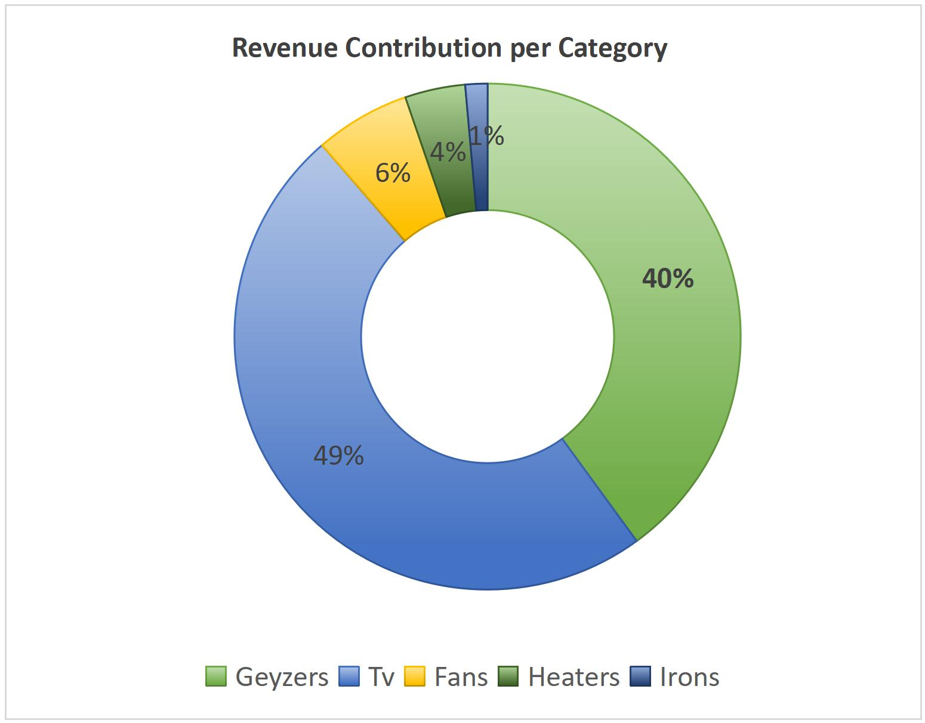
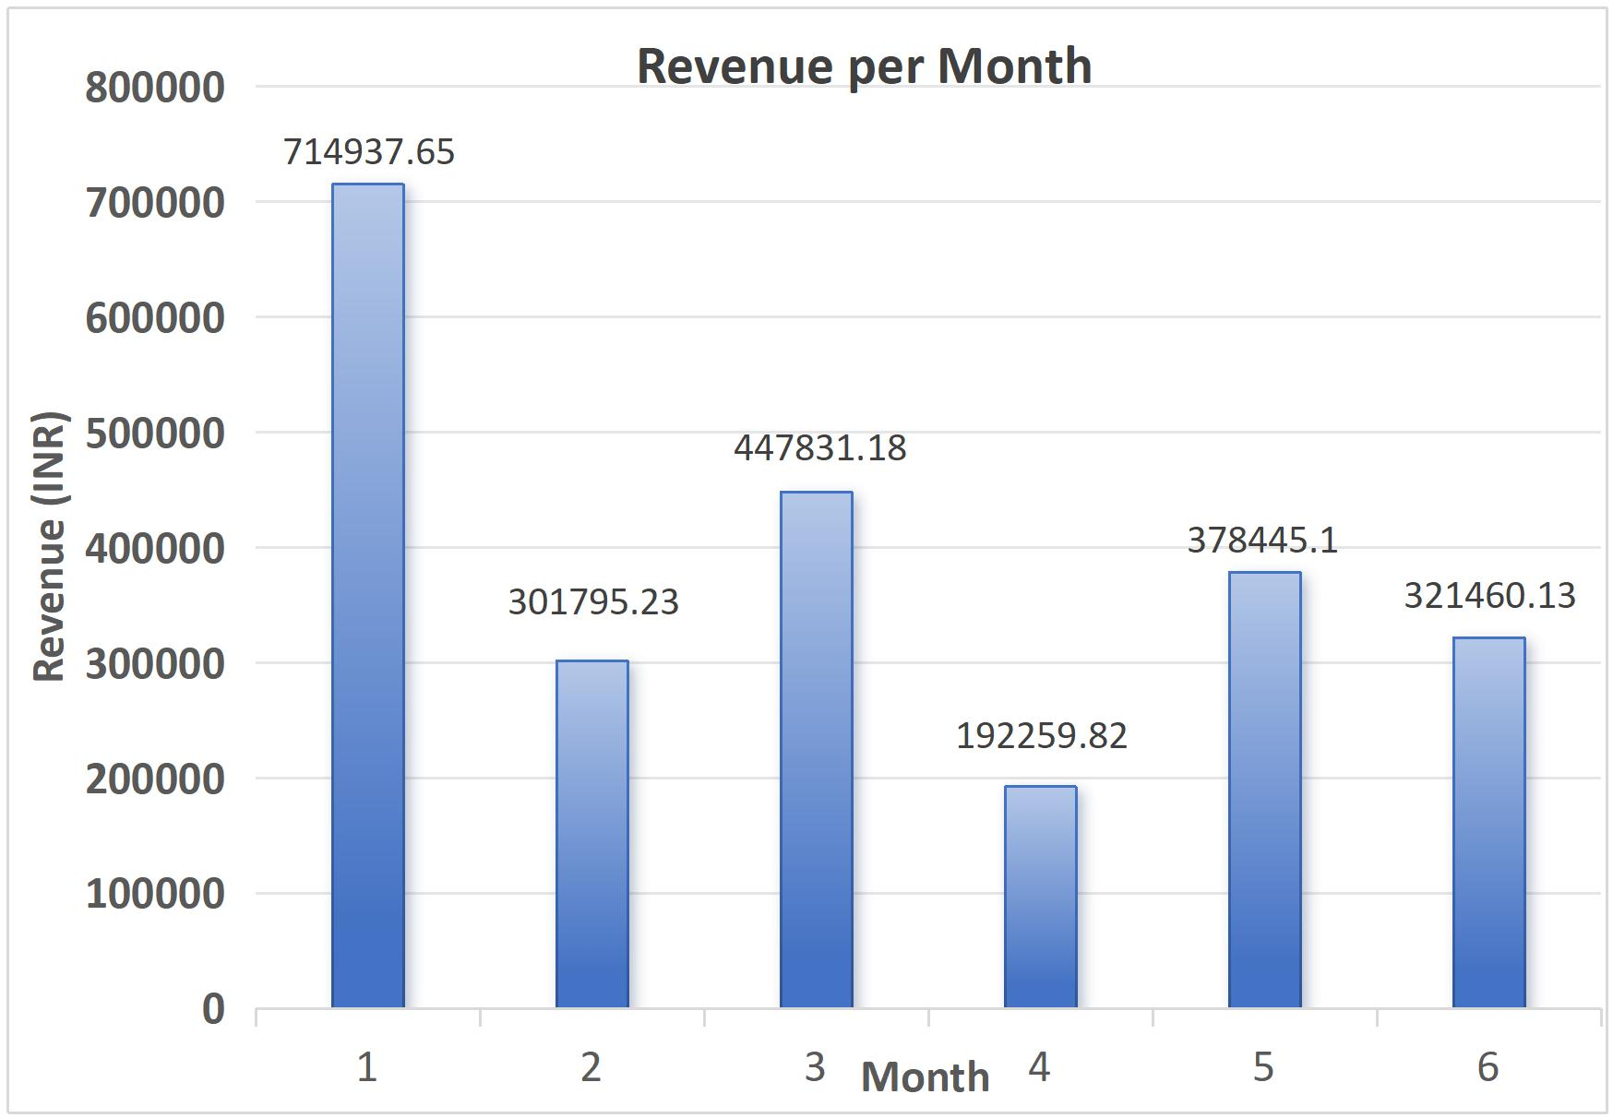
Results & Findings
1) Revenue contribution per category:
The Geysers and TV make up for the 89% of the total revenue.
LED 40" alone has contributed 49% of total sales.
Individual geyzer contributions are:
35 LTR Geyser & 50 LTR Geyser : ~30% ,
25 LTR Geyser(V1) : 7%
Geyser 25 LTR (V2) : 3%
2) Monthly revenue:
Peak Sales: January recorded the highest sales (INR 7,14,937.65)
Lowest Sales: April had the least sales (INR 1,92,259.82)
Monthly Growth Rates:
● February: Decreased by 57.8%
● March: Increased by 48.4%
● April: Decreased by 57.1%
● May: Increased by 96.8%
● June: Decreased by 15.1%.

Slide 6
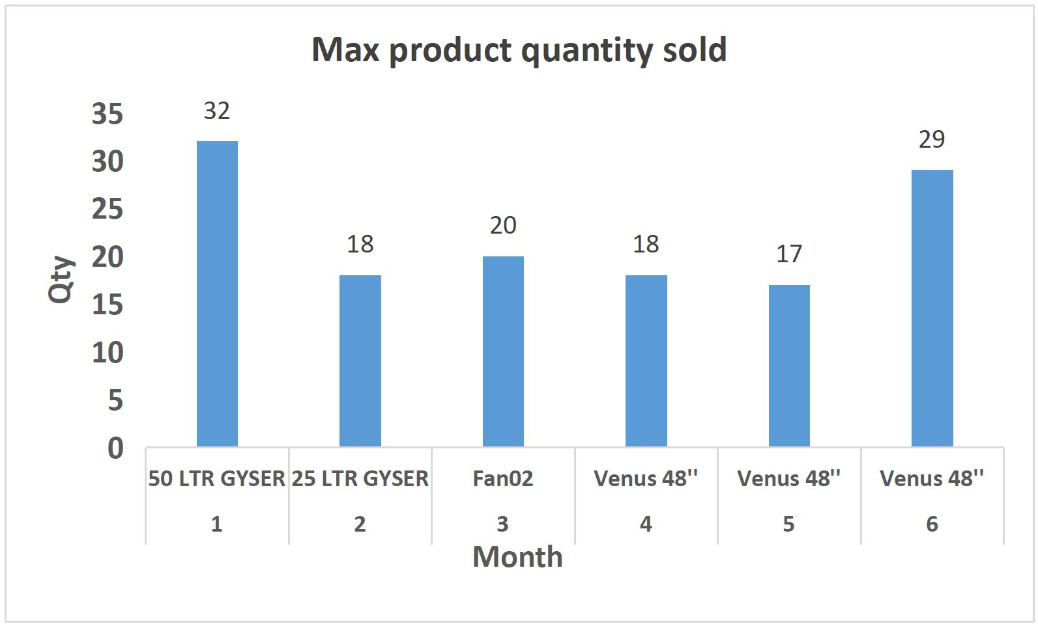
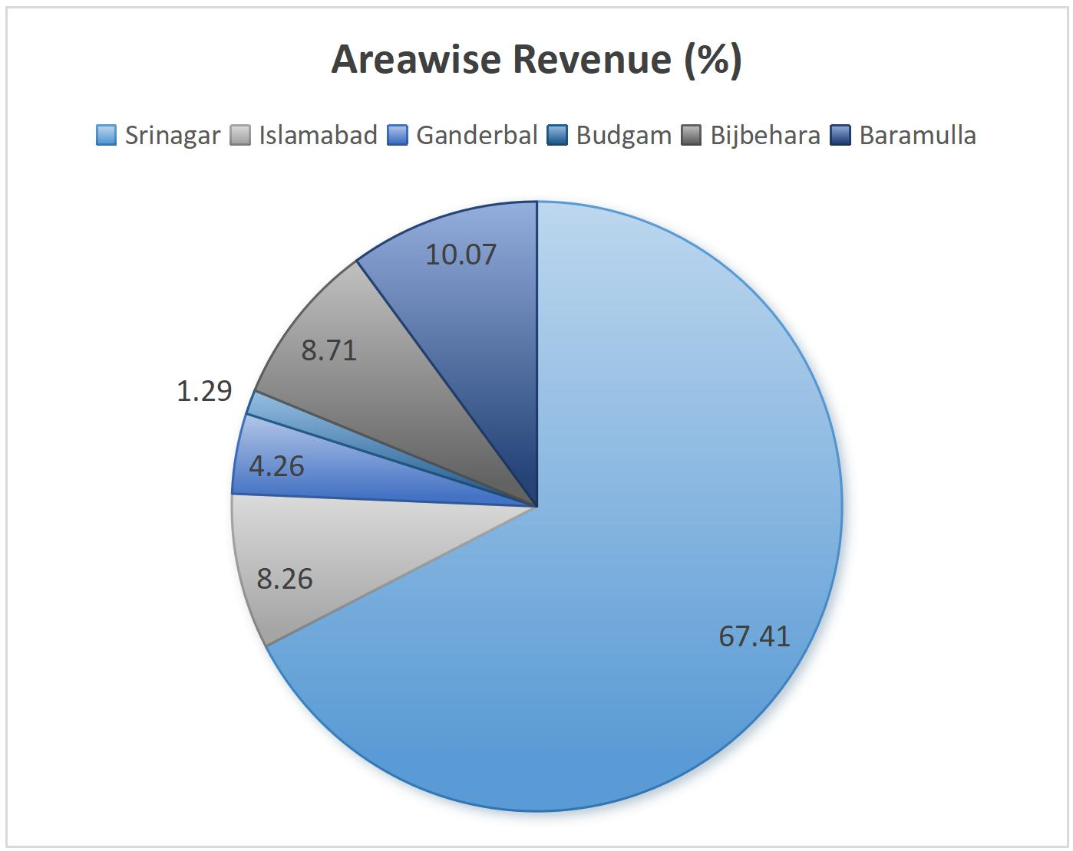
3) Product trend Analysis:
Geysers were the top sellers in January and February, but from March onward, fan sales overtook them, while LED TV sales remained consistent throughout.
Top-selling products were:
Venus 48" : 64 units (14.09%)
35L Geyser: 55 units (12.11%)
LED 40" : 52 units (11.45%)
Lowest-selling items included:
Iron M-105: 31 units (6.4%)
25L Geyser (V2): 16 units (3.3%)
4) Top performing areas:
Highest Sales Region: Srinagar (INR 15,88,652 - 67.41% )
Lowest Sales Region: Budgam (INR 30,410 - 1.29% )
This strong performance of Srinagar is supported by the presence of 34 active dealers, indicating a well-established distribution network and a large customer base.
Islamabad and Bijbehara follow as the next best-performing regions, likely benefiting from a relatively higher dealer presence- 6 in Islamabad and 7 in Bijbehara
On the other hand, Budgam ranks as the lowest-performing region, with sales totaling only Rs 30,410, representing a mere 1.29% of the overall sales

Slide 7
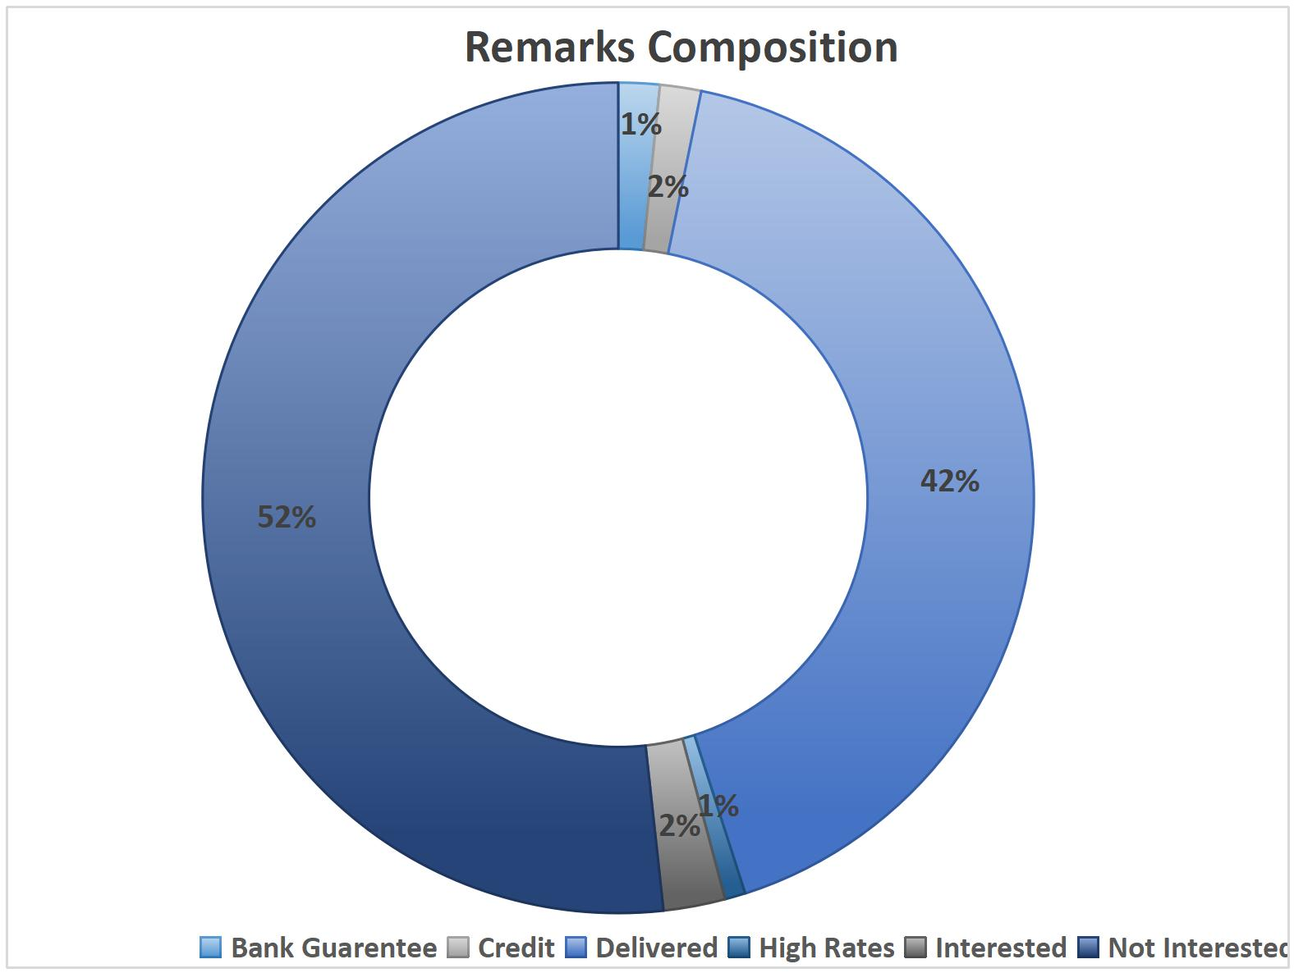
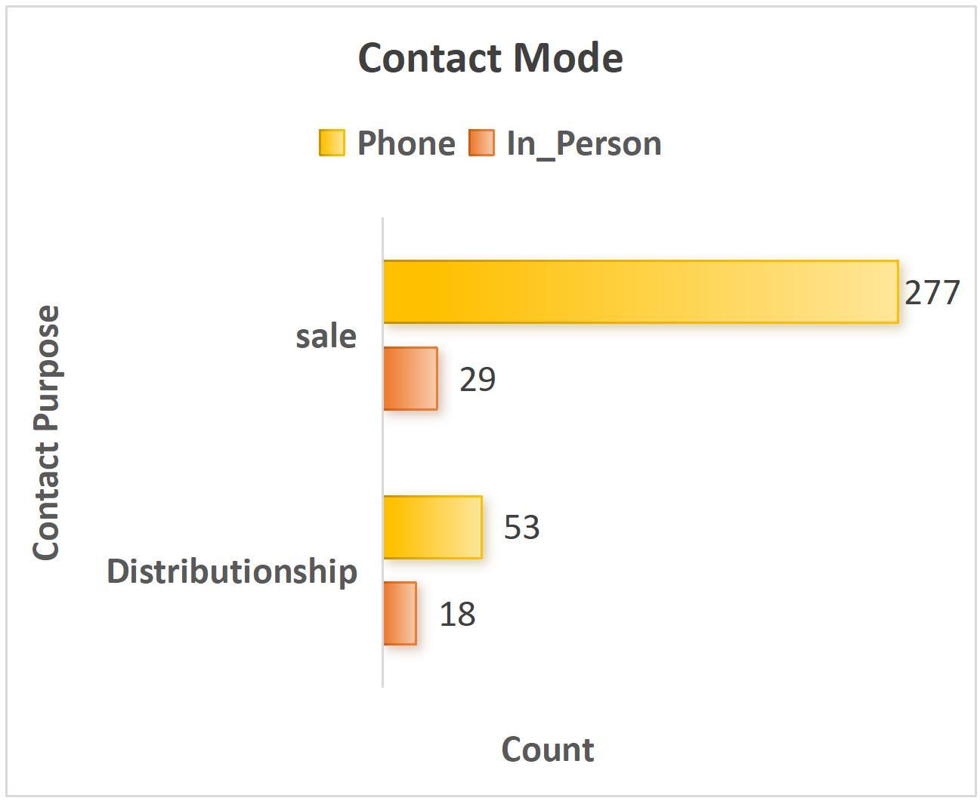
5) Remarks Analysis:
The main reason for lost sales is customer disinterest, cited in 52% of cases.
Financial issues, like credit or bank guarantee problems, were noted in 12 instances, showing it's a barrier for some buyers.
High pricing was a concern in only 3 cases, indicating price isn’t a major obstacle.
Additionally, 5 interested leads didn’t convert, likely due to weak follow-up or unrest in the region.
6) Contact mode effectiveness:
Phone calls made up 87.2% of all interactions, mainly effective for maintaining existing dealer relationships, with a 43% success rate.
In-person visits, though only 12.8% of total engagements, had a higher success rate of 51% and generated stronger interest, highlighting the value of personal interaction with potential dealers.

Slide 8
Interpretations & Recommendations
1. Reduce Overdependence on Limited Products:
TVs and geysers contribute 89% of total revenue, making the business vulnerable to sales fluctuations in these categories.
2. Stabilize Seasonal and Regional Sales Variability:
Sales peak in January but fall sharply by April, and most revenue is concentrated in Srinagar due to high dealer presence.
Recommendation:
Recommendation:
Diversify the product portfolio with mid-range and seasonal appliances (e.g., air coolers, compact geysers).
Promote underperformers via combo deals like “Home Essentials” bundles.
Monitor product performance post-promotion and phase out consistently low-sellers.
Create a seasonal campaign calendar aligned with local festivals and climate needs (e.g., fans in summer, geysers in winter).
Expand dealer networks in underperforming areas (Budgam, Baramulla) with recruitment incentives and monthly training programs.

Slide 9
3. Improve Lead Management and Conversion Strategy
45% of leads drop due to customer disinterest, not affordability, with phone calls being less effective for new acquisitions.
4. Refine Product Strategy and Optimize Underperformers
LED 40” TVs and geysers are top performers, while irons and low-capacity geysers underdeliver.
Recommendation:
Recommendation:
Train sales staff in consultative selling and follow a structured contact funnel (call → WhatsApp → visit).
Adopt a hybrid contact strategy: phone for current dealers, in-person for potential ones.
Capitalize on star products through promotions, EMI options, and service packages.
Introduce variants (e.g., smart TVs, compact geysers) for broader appeal.
Rebrand or bundle weak products, or offer them as dealer incentives or bulk-buy bonuses.

Slide 10
THANK YOU!

